Slide 1
SEE YOUR DATA IN A NEW WAY
A Use Case for
Near Real Time
OLTP Dashboard Design
Ram Vantipalli
ram.vantipalli@hp.com
Sean Swick
sean.bow.swick@hp.com
Notes:
The material we will present today has been reviewed by our client, the US Army, and has been approved for public release for this CodePaLOUsa 2013 presentation.

Slide 2

The Business Process
Lead
Prospect
Applicant
Contract
Floor To Enlist
Test Passed
Test Scheduled
Appt Conducted
Appt Made
Lead
1
3
5
ANALYTICS
10
20
40
100

Slide 3
Issues
Lack of Visibility to Applicant Processing Status
Decade-old Database Design
Evolution and Coexistence of Applications
  Thick Client Apps
  Browser-based Apps
  Mobile Apps
Increasing User Base along with
Increased Utilization
  Currently around 20,000
  Increased reporting demands (status updates)
Database Spinlocks and Contention
Poor User Experience

Slide 4
The Problem
Design a dashboard displaying actionable summary data, having immediate access to underlying detail data
Required data resides in heavily accessed OLTP production tables used extensively by existing applications
Summary and detail data must be current and synchronized
Detail data is volatile and/or in large datasets
Solution can NOT degrade current production application performance
Notes:
To reduce the system load, a drilldown dashboard was to be designed that would eliminate the persistent screen/reports being requested by users. The data most often requested was to be identified and placed in new detail tables.
The dashboard was not to be only an output of graphs and numbers, but an interactive portal to the processed data. It was to be actionable.
‘Actionable’ means that the user can perform one or more functions, or actions, on data displayed on the computer screen. In practice, this means the objects or links you see on the dashboard screen should be functional and provide a user with the underlying detail data.
And what we are presenting today, is how we accomplished the mission with the given constraints.
The solution that we are showing today is Hardware, software independent, you should be able to accomplish the results with the existing infrastructure that you have.

Slide 5
The Solution
Notes:
These are the components of the Solution that was architected.
Business Events:
Transactions that represent a meaningful business condition or occurrence. In our case, it was basically the movement of an lead/prospect/applicant from one stage in the business process to another.
Database:
This solution uses an OLTP production structured database.
Active / Passive Tablesets:
Allows your front end app to maintain continuity by directing the UI to the Active table set while the process ‘works on’ the passive set.
Process Control:
Sequencing of jobs, error handling, scheduling, etc.
Batch Processing:
How do you eat an elephant? One byte at a time.
Front End:
Choose your flavor: n-Tier Web-based REST Interface

Slide 6
Business Events
Transactions representing meaningful business activity
Process Outputs
Database Triggers
Change Data Capture
Event Queue
Notes:
Business events are not required to be identified prior to initial development. These can be ‘afterthoughts’ that business defines after the application is in production, or additional requirements generated after production deployment. Capturing these events through a detached, or ancillary, process allows low impact data collection and out-of-band processing. For our client, some of the applications had already been running for years.
Events are captured with timestamp information to enable chronological processing.
NOTE: While Database Triggers are shown here as one possible source of events, it is the most impactful of the three on production performance and should be used sparingly. To minimize impact, implement the triggers as ‘no load’, meaning that no logic exists within the trigger code and the target tables of the trigger INSERTs have only a unique ‘counter’ primary key.
Some data sources may send records multiple times for the same event, or the same event may be reported from multiple sources. The system must be able to process the multiple events, presenting as duplicates.

Slide 7
Batch Processing
Batch Events
Clear/Prepare Passive Detail Tables
Copy Active to Passive
Process Events and Summarize Data
Update Active Table Pointer
Event Queue
www
Active
Notes:
Active/Passive Strategy:
The active/passive tablesets allow the user to view the active tableset data, while the passive tableset is rebuilt ‘in the background’ using updated detail data.
Batch Events:
Finding the right batch size will require tweaking to maintain the desired latency, or age of data. This type of batch processing in known as ‘micro-batch’ and allows achievement of near real time results.
Clear/Prepare Passive Detail Tables:
Passive detail tables will be truncated or, in some cases, data changes will be detected using CDC and prepared for replication.
Copy Active to Passive:
Detail data is copied from Active to Passive tables. Detected data changes from CDC are updated to Passive tables.
Process Events and Summarize Data:
Detail data is summarized and summary tables are updated.
Update Active Table Pointer:
System applications using the summary and detail tables look at an active table pointer in a database table to see which tableset to access, A or B.

Slide 8
The Solution

Slide 9
Database
Active / Passive Dataset Strategy
Database Engine
  SAP Sybase Adaptive Server Enterprise
  Oracle
  MSSQL
Important Details
  Fast I/O – Load is heavy for I/O
  Well Architected Detail and Summary Tables
  Tuned SQL Stored Procedures
    Query Plans
    Good Indexes and Index Hints
  Resource Availability (tmp space, RAM, etc.)
Notes:
1st Bullet:
The Active / Passive Strategy was implemented for several reasons:
The summary and detail data must remain in synch. If a user selects a summary object, like a bar graph, that indicates a count of 7 (which is the summary), the detail tables must have those 7 records to return.
Incoming events are processed continually, and as detail data is updated, statuses can change. These changes are applied to the passive detail tables and will be visible at the end of a cycle.
The user experience is greatly enhanced by pointing the GUI interface to the active tableset, which contains most of the required data, instead of at busy/large core database tables. The active tableset also contains a good portion of the ‘drill-down’ detail data the user might need, further lessening the need to hit core tables.
2nd Bullet:
With this solution, you can use any enterprise class database system you wish: MSSQL, MySQL, Oracle, DB2, etc.
3rd Bullet:
The caveats are that you must have very good SQL developers and sufficient hardware resources. Database admin experience is also a HUGE plus.

Slide 10
The Solution

Slide 11
Process Workflow
Job scheduling
Process Flow Sequencing
Process can be automated and managed utilizing a variety of enterprise tools
  IBM Datastage
  CA AutoSys
  MS SSIS
  ASCI Active Batch
Implement parallel architecture for higher throughput
Notes:
2nd Bullet:
Logical groupings of jobs… dependencies… job completion table…
Tuning involved analysis of job runtimes and determining what jobs could be run in parallel and what dependencies existed between jobs.
3rd Bullet:
These four enterprise tools can also manage parallel workflows.

Slide 12
The Solution

Slide 13
Parallel Architecture
Multi-core Computing Model
Amdahl’s Law
Jobs are designed to be executed in parallel
Capacity to process over 2 Million events in 24 hrs,
while maintaining dashboard latency < 5min
  76 Unique Defined Business Events
Notes:
Our solution is able to process over 2 Million events per day using up to eight cores on one physical cpu, without the Parallel Engine. This solution is architected logically in parallel, and can be scaled to process as many events as necessary.
Currently, nearly 2 Million records are touched on every batch cycle.
1st Bullet:
Single processer, multi-core.
2nd Bullet:
Improvements in run time will be limited to how much of the process can be run in parallel, and how long it takes for your critical path to execute no matter how many processing units you throw at it. Your sequential job constraints will form your critical path.
3rd Bullet:
4th Bullet:
WHY NOT MORE? Can’t it go any faster?
While the DataStage tool is capable of managing much more parallel processing power, it wouldn’t help much to reduce runtimes. Constraints, such as the transactional database I/O and sequential job dependencies create a critical path barrier to further significant improvements.

Slide 14
The Solution

Slide 15
Batch Processing
Utilizing right-sized batches allows the system to process a manageable number of events, while allowing the user to experience a stable and reliable environment.
The sweet spot of batch size depends on several factors:
Complexity of business rules
Acceptable age of displayed data (Cycle Time)
Volume of event flow
System Performance
Notes:
At the end of the day, you’re going to have to test the system to find your batch size. Load the queue up with events and adjusting the batch size, looking at how long it takes the cycle to complete.
You’ll need to do this after deployment to production. Our process monitors the cycle time and notifies us if it exceeds a set number of minutes.

Slide 16
Batch Processing
Notes:
20 hour processing day. This allows for a maintenance window and resource allowance for other processes.
What we found is that beyond a certain batch size, the cycle time started to increase and quickly showed a diminishing return for increased batch size.
1250 batch processed in 2.5 min = 0.6M/day
2500 batch processed in 2.5 min = 1.2M/day
5000 batch processed in 2.5 min = 2.4M/day
10000 batch processed in 8 min = 1.5M/day

Slide 17
The Solution

Slide 18
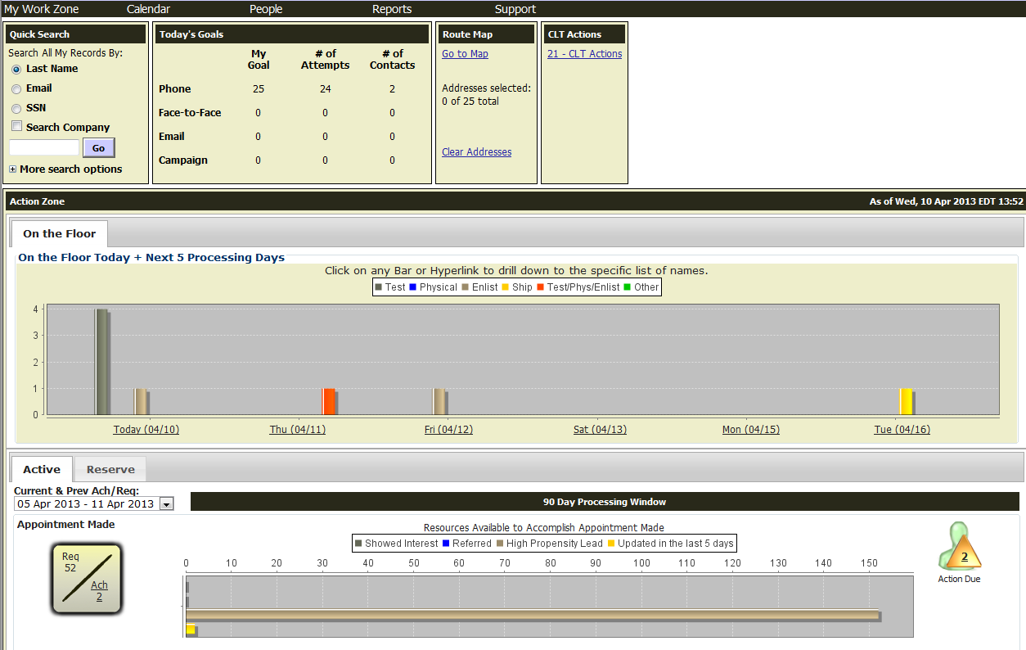
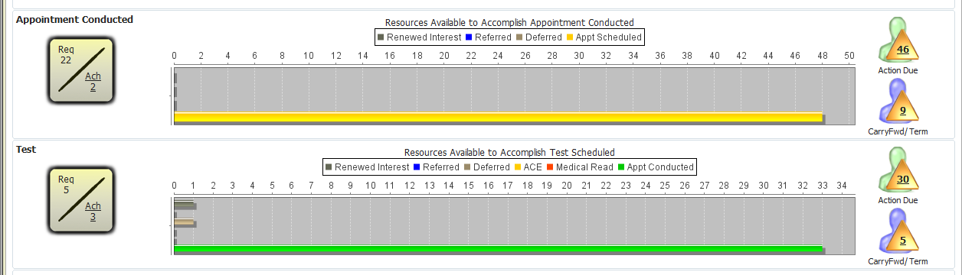
Front End
Notes:
Implement a front end GUI that supports n-Tier REST. There are a lot of tools out there, as many of you know, that can create graphs and interface with the database.

Slide 19
Applications
Logistics
Analytics
Dashboard
Automation Systems
Game Engine
Notes:
UPS recently introduced a premium service, allowing you to see when a package delivery is within two hours. This process could have been implemented using a similar solution, triggering off the deliveries already made on their route. This location/delivery data already existed in the system and this new process developed after the fact.
Data Warehousing is typically a 24hr process, updating during OLTP off-peak times. Businesses need dashboards that reflect more current data and this gets as close to real-time as you can, without actually taxing your OLTP databases.
Implementing CDC instead of triggers can further isolate this type of process from production database loads.
Any application that captures events or messages, signifying specific business events, can utilize this type of solution or some variation of it.

Slide 20
Live Demo

Slide 21
Q & A

